Slide 1
Modeling Self Driving Vehicles
Caleb Madsen, Brian Horne, Alex Smith
https://github.com/ASU-CompMethodsPhysics-PHY494/final-2017-openthepodbaydoors_hal.git

Slide 2
Background
Can we optimize traffic flow with only a few simple rules?
The fact that we have traffic laws suggests that this is already being tried. However, people are unpredictable, and do not follow laws so well. Machines however, follow rules quite precisely. So, if machines were to drive us, instead of us driving machines, could we find them a set of rules which optimizes traffic flow? By simulating a network of traffic, in which each agent is under the same constraints, this project aims to provide some perspective on this question.
In the age of information and automation, many people have recognized that public/private transportation could become fully automated, and it’s well on its way. In the public sector, modes of transit systems such as the light rail are almost entirely automated. And in the private sector, companies such as Uber, and Google are developing technologies such as self driving cars, right now!
Beyond the challenges of developing an individual smart car, there lay large scale challenges that result from interactions of many smart cars. This project addresses the problem concerning the efficiency of traffic for many cars, which all obey the same exact rules.

Slide 3
RESULTS
Simulation of Traffic flow over 10 times steps with varying number of cars on the road:
Low Density 1-10 cars per position initially
High Density 6-10 cars per position initially

Slide 4
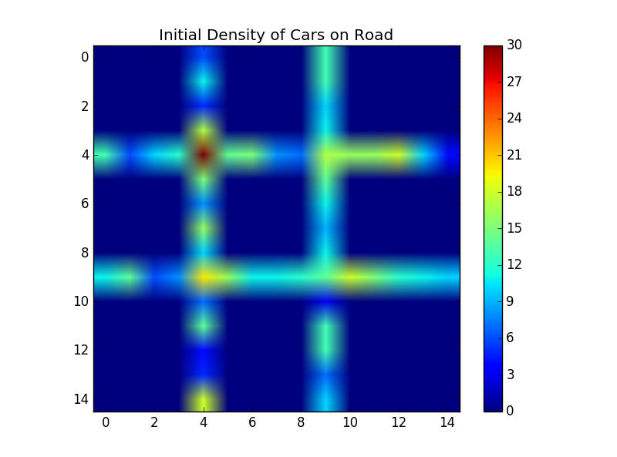
Low Density Simulation Initial position of cars

Slide 5
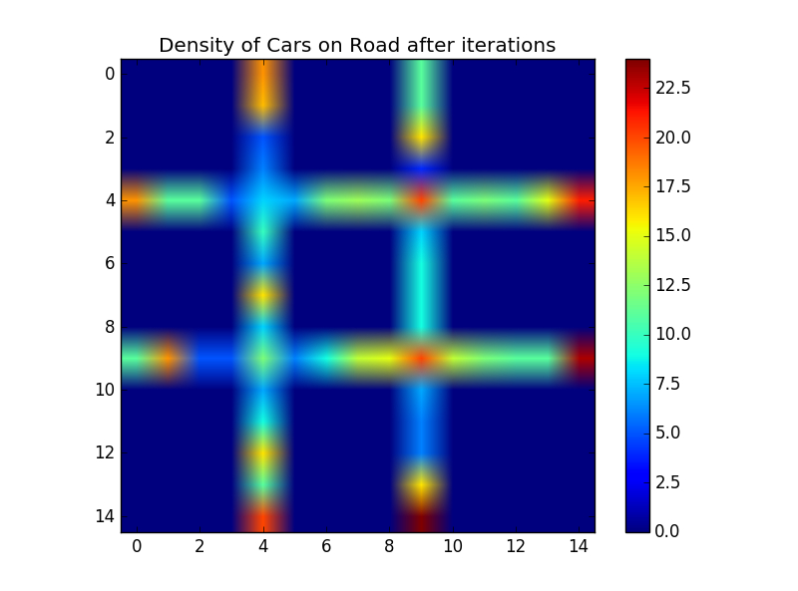
Low Density Simulation after 10 timesteps

Slide 6
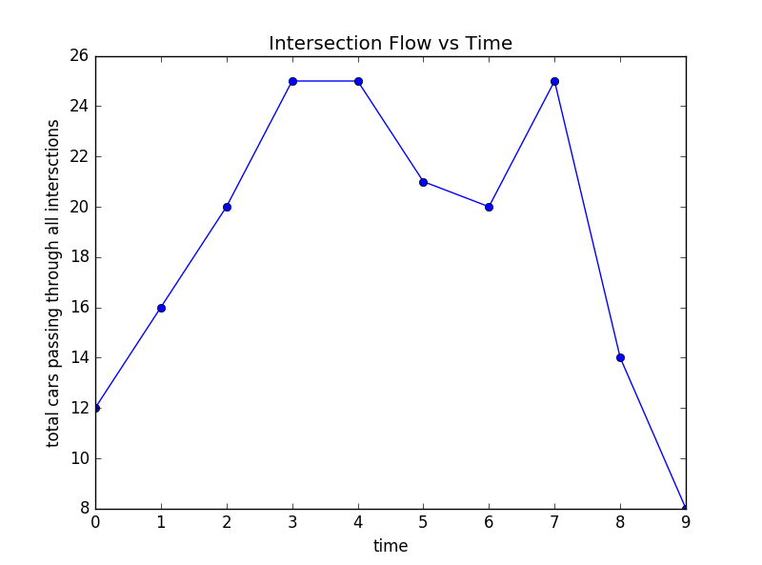
Low Density Simulation: Total flow through all intersections after 10 timesteps

Slide 7
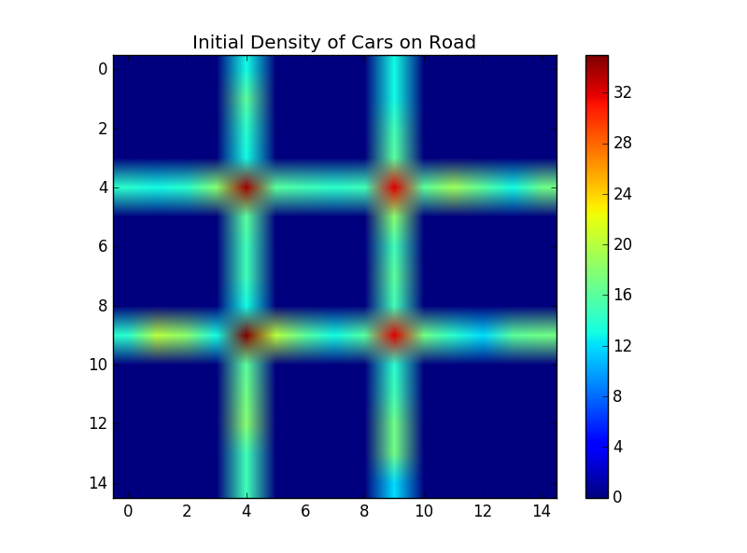
High Density Simulation: Initial Positions

Slide 8
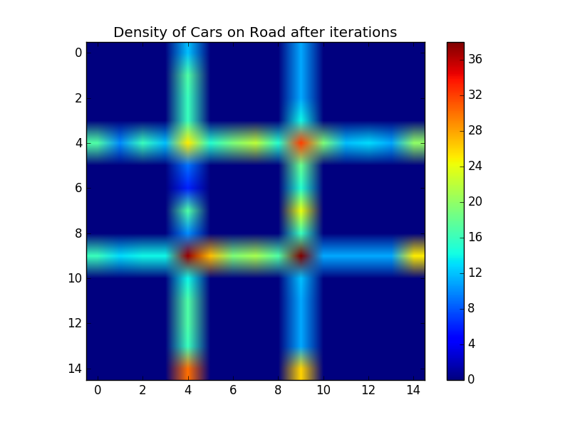
High Density Simulation after 10 timesteps

Slide 9
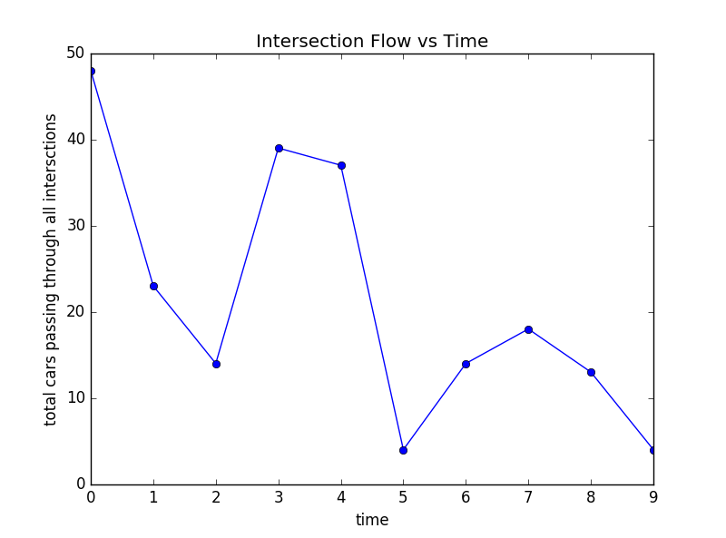
High Density Simulation: Total flow through all intersections after 10 timesteps

Slide 10
Methods
Project Mgmt – Central Questions:
What problem are we solving?
Why are we solving it?
How will we approach finding a solution?
How will we break up the work?
What technical/programming methods will be most effective?
These are the questions that repeatedly helped focus our efforts and attention so that our team could work to maintain constant progress

Slide 11
Methods
Technical Approach:
Boolean logic
Interdependent looping methods
Array manipulation and slicing
Plotting data like heat flow to better visually represent traffic
Multi-directional arithmetic motion function
If/else statements
Module organization and implementation
Dictionary data type for information storage and processing

Slide 12
Summary
In retrospect, the difficulty and scope of this project were not completely understood at the outset, and this led to some speed bumps in our progress
Our code was able to set up an environment, populate it, and measure traffic’s system-wide performance over multiple iterations
Our code was also able to visualize these data in a digestible manner
We struggled to implement many of our stretch goals due to the underestimation of the project’s difficulty
We remain excited about the modeling of these systems

Slide 13
References & Acknowledgements
Dr. Beckstein
Ian Kenney
Geoff Hulten
Stack Overflow
Python.org
Quora.org

